Slide 1
VOIS Innovation Marathon 2025-2026
Project Title – Intelligent shopping Agent
Team Number – 82
Name of Team Members-
Rushil Dhale
Sampada Akkar
Devendra Dhokare
College Name –Marathwada Mitra mandal’s Institute of Technology (MMIT) Lohegaon

Slide 2


AGENDA
Problem statement
Project Overview
Need of project
Your solution
Technical Flow Diagram
Result
Future Scope

Slide 3

PROBLEM STATEMENT
In the modern e-commerce landscape, consumers are overwhelmed by the vast number of choices available, making it difficult to pinpoint the right product.
Product details are scattered across various websites, and prices fluctuate constantly. Tracking these changes manually across different platforms is nearly impossible.
Manual comparison is time-consuming and often leads to "choice paralysis" or missed financial deals due to a lack of real-time data.
There is a lack of an automated, intelligent system that consolidates this data to help users make informed, cost-effective decisions efficiently.

Slide 4

PROJECT OVERVIEW
Objective: To develop an automated software agent that assists users in finding the best products at the lowest prices across multiple e-commerce platforms.
Domain: Artificial Intelligence, Web Scraping, and Data Analytics.
Core Concept: The agent acts as a personalized assistant that aggregates product data, compares prices, and analyzes user reviews to simplify purchasing decisions.

Slide 5
NEED OF PROJECT
Combating Cart Abandonment : With over 70% of online
carts left behind because of complexity or hidden costs, there is an urgent need for an efficient shopping helper.
Time Efficiency : The modern consumer does not have the time to research on their own. The system offers a tremendous advantage of time efficiency since it facilitates decision making.
Requirement for Instant Support : The customers require instant support while shopping. An automated agent can bridge this deficiency as an automated agent can provide instant support round the clock, unlike a human being.
Value Optimization & Quality Assurance : Consumers should look for the best possible saving offered in the form of deals, in addition to taking advantage of the benefits of loyalty points.

Slide 6

WHO ARE THE END USERS?
Time-Constrained Professionals: Users looking to automate routine purchases like groceries or household essentials.
Bargain Hunters: These are students and smart consumers who seek to get the greatest value out of their money.
Elderly : Users who benefit from voice-activated shopping and intuitive AI guidance.
Retail Brands: Businesses seeking higher conversion rates and deep insights into customer trends

Slide 7

OUR SOLUTION AND ITS VALUE PROPOSITION
Unified Dashboard: A single interface to search for a product and see results from multiple retailers (e.g., Amazon, Flipkart) to ensure the lowest total cost simultaneously.
Natural Conversation: Finds products through dialogue instead of rigid keyword hunting.
Cross-Platform Orchestration: Distributes a single shopping list across various retailers (e.g., Amazon, Flipkart) to ensure the lowest total cost.
Seamless Integration: Connects with real-time inventory systems to prevent out-of-stock frustrations.

Slide 8
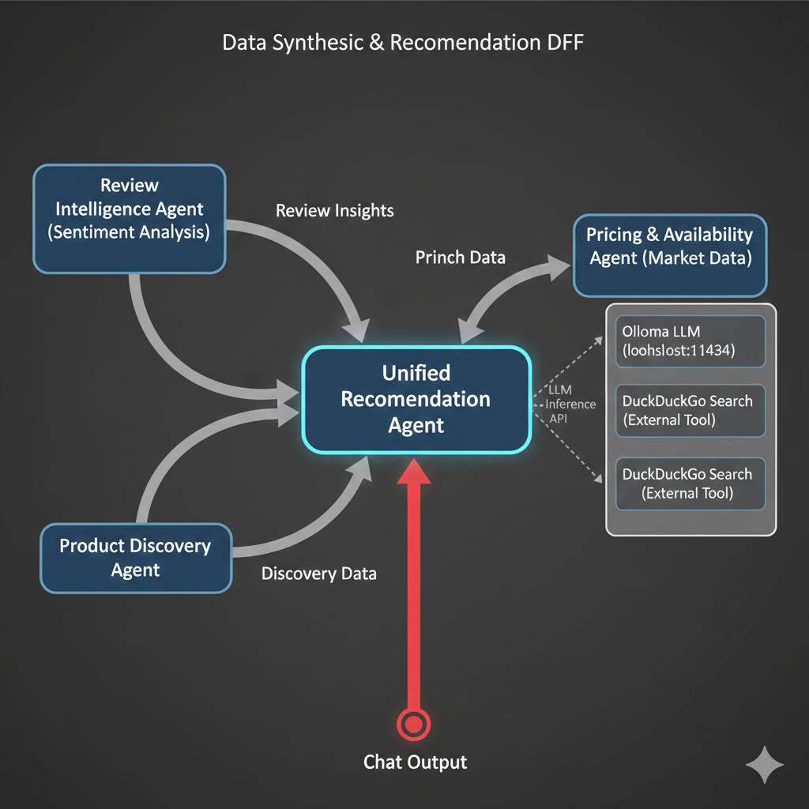
TECHNICAL FLOW FOR THE AGENTS
PHASE 1:- DATA SYNTHESIS AND RECOMENDATION

Slide 9
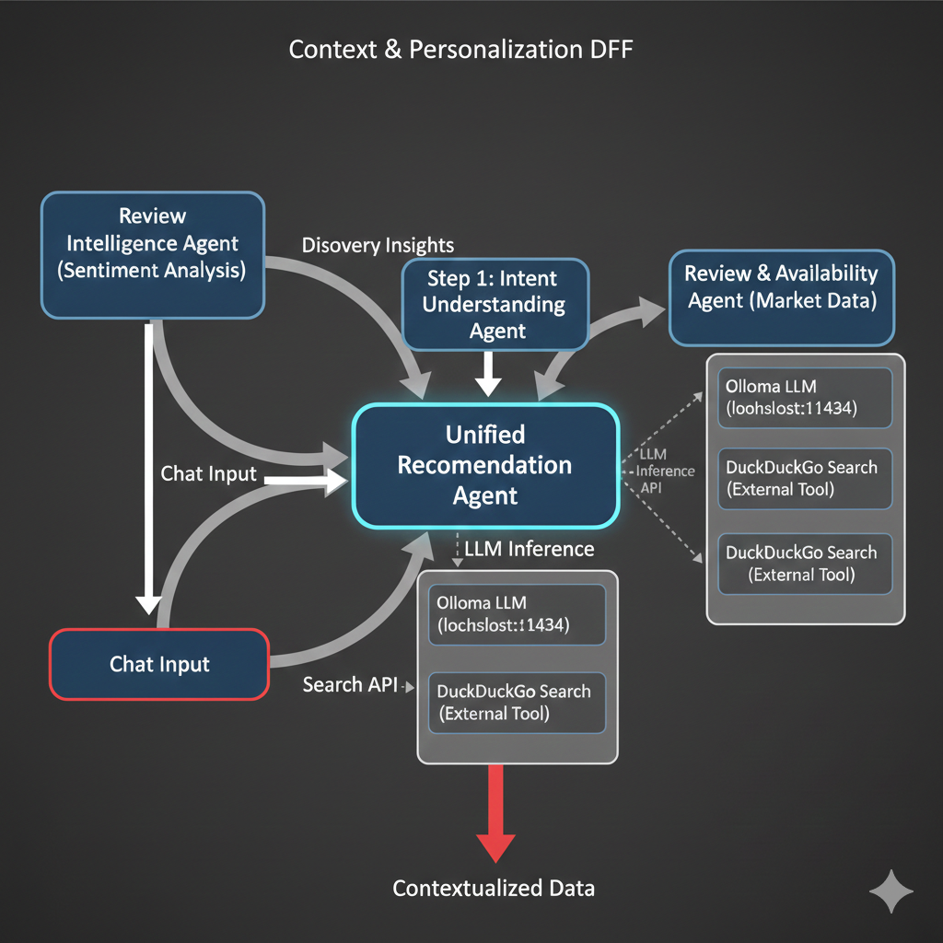
TECHNICAL FLOW FOR THE AGENTS
PHASE 2 :- CONTEXT AND PERSONALIZATION

Slide 10
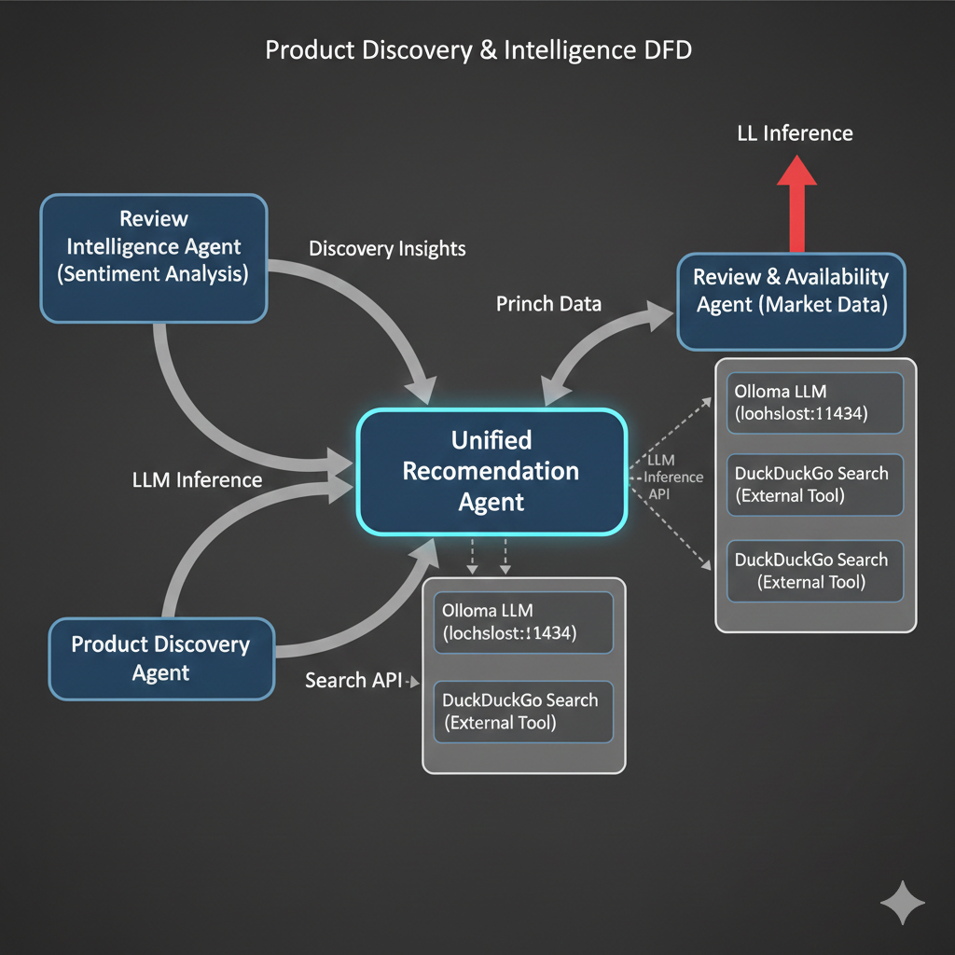
TECHNICAL FLOW FOR THE AGENTS
PHASE 3 :- PRODUCT DISCOVERY AND INTELLIGENCE

Slide 11
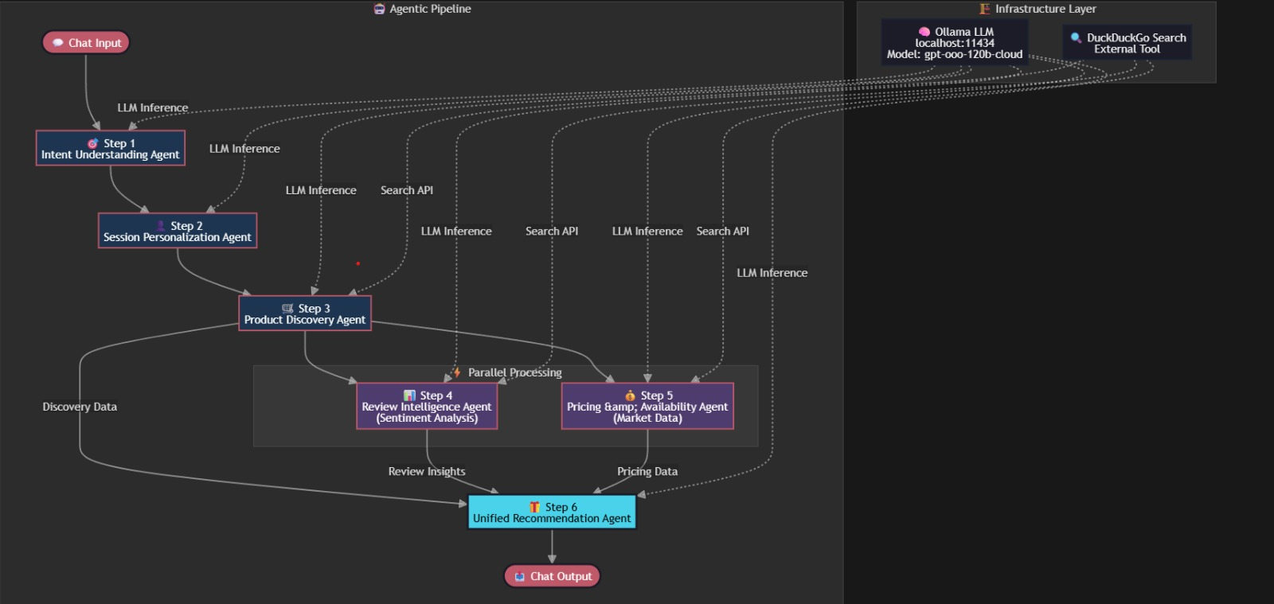
OVERALL DFD OF OUR PROJECT

Slide 12

THE WOW IN OUR SOLUTION
It tells you specifically why a product is good or bad so you don't have to read the reviews yourself.
It factors in shipping costs, hidden fees, and potential loyalty point rewards to reveal the actual cheapest option, not just the sticker price.
A single search query fetches and standardizes data from rival platforms instantly, making the fragmented market feel like one unified store.
By flagging items with high return rates or fake reviews, it actively prevents "Buyer’s Remorse," acting as a guardian rather than just a search engine.

Slide 13
MODELLING 1. Cognitive Layer (Intent & Context) Intent Agent: Parses raw text to identify product specs & budget. Personalization Agent: Maintains session memory for context-aware responses. 2. Research Layer (Discovery) Discovery Agent: Selects relevant retailers and categories. Web Search Agent: Uses DuckDuckGo for real-time pricing & availability data. 3. Evaluation Layer (Validation) Review Intelligence: Analyzes sentiment and user feedback for reliability. Pricing & Availability: Filters for in-stock items with the best value 4. Communication Layer (Delivery) Unified Recommendation Agent: Aggregates findings into a conversational summary with direct purchase links

Slide 14
RESULTS
Efficiency: Significant reduction in "Time-to-Purchase" by automating the discovery and comparison phases.
Accuracy: High-confidence recommendations derived from the "Unified Recommendation Agent" which cross-references reviews and live pricing.
User Experience: A seamless, conversational chat output that hides the complexity of the underlying agent mesh
Demo Link

Slide 15
FUTURE SCOPE
Implement "Snap and Shop" capabilities where users can upload a photo to instantly find the exact product or similar look-alikes.
Integrate AR to let users visualize products in real-time—such as placing furniture in their living room or trying on sunglasses virtually before buying.
Expand to Offline-to-Online (O2O) integration, showing users if the product is available right now in a physical store nearby for immediate pickup.
Develop a secure, fully automated checkout bot that can log in, apply coupons, and complete the transaction on the user's behalf with a single "Confirm" voice command.
Connect with Smart Home devices (like Smart Fridges) to automatically order consumables (milk, laundry detergent) when supplies run low, without user intervention.

Slide 16
GITGUB LINK
https://github.com/rushil-cody/VOIS_team_82
git hub Link

Slide 17

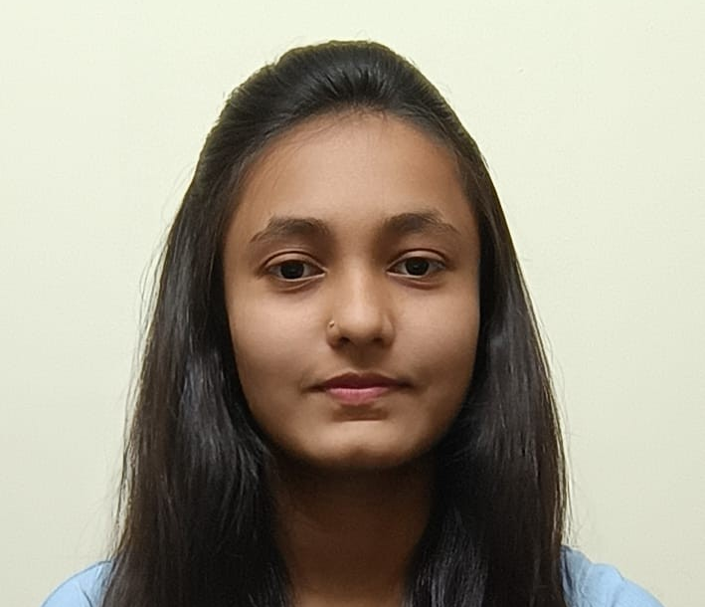
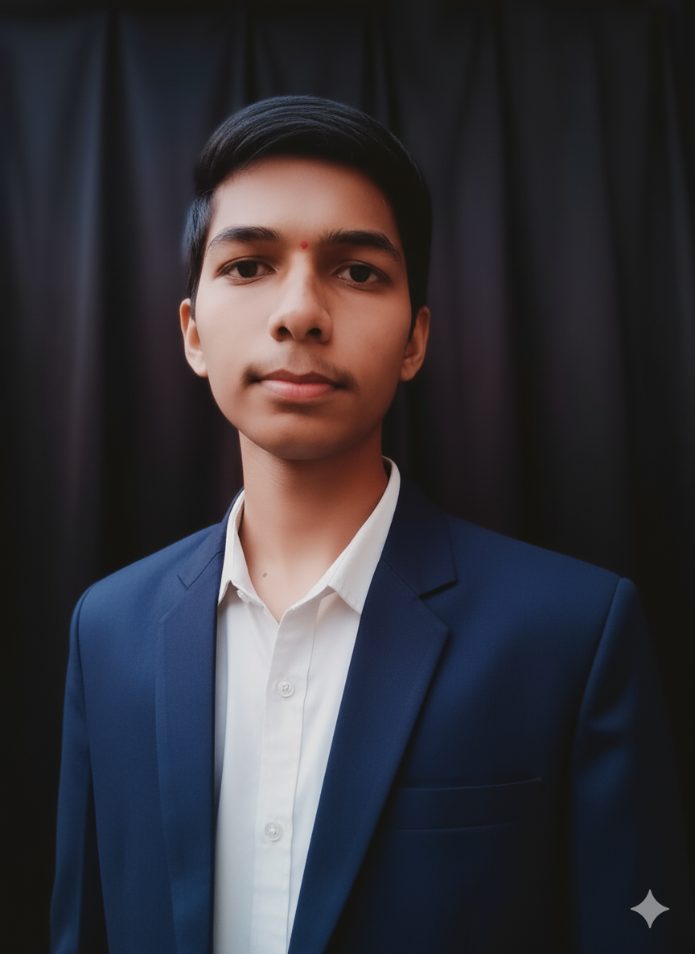
MEET OUR TEAM
Rushil Dhale (team leader )
.
Sampada Akkar Devendra Dhokare

Slide 18

CREDITS
Stakeholders [none] | Name of Subject Matter Experts(SMEs)/Mentor from Edunet Foundation Mr. Deepneel Majumdar | Name of College Mentor Mrs. Vidya Kadam

Slide 19
REFERNCES
VOIS Innovation Marathon Guidelines: Provided documentation for project structure and evaluation criteria.
E-commerce Trend Reports (2025): Research on decision fatigue and choice overload in modern digital retail.
Customer Experience Studies: Research work done on the impact of AI agents on cart abandonment and personalized shopping journeys

Slide 20
THANK YOU
.

